Slide 1
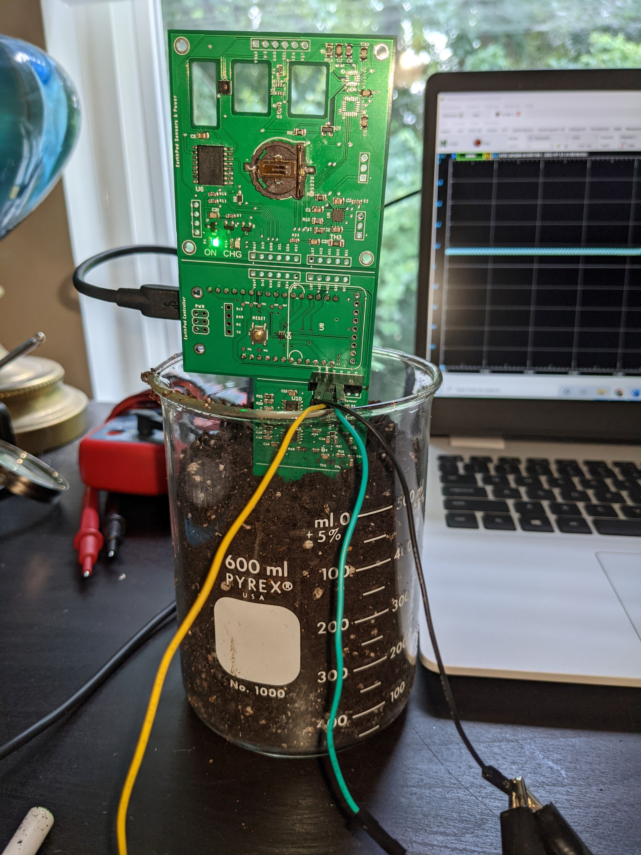
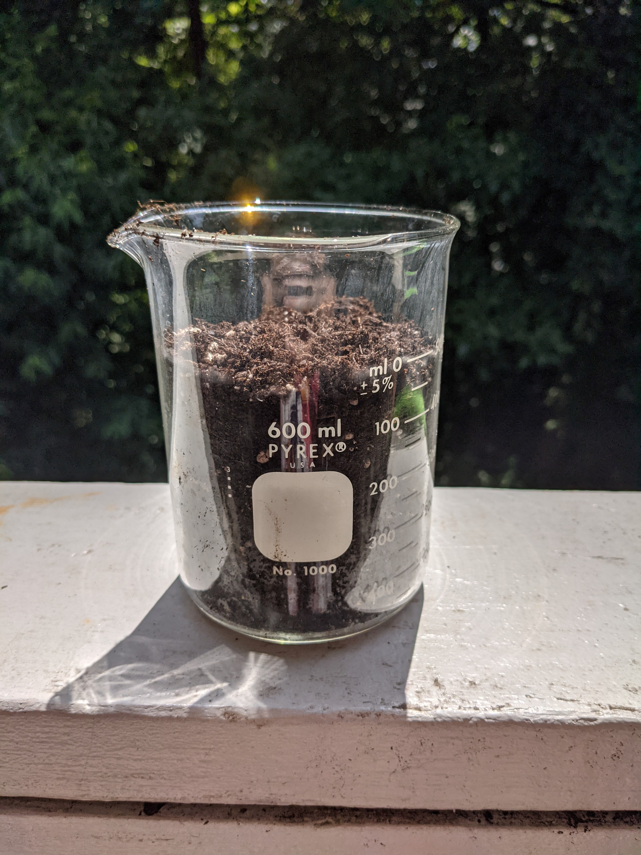
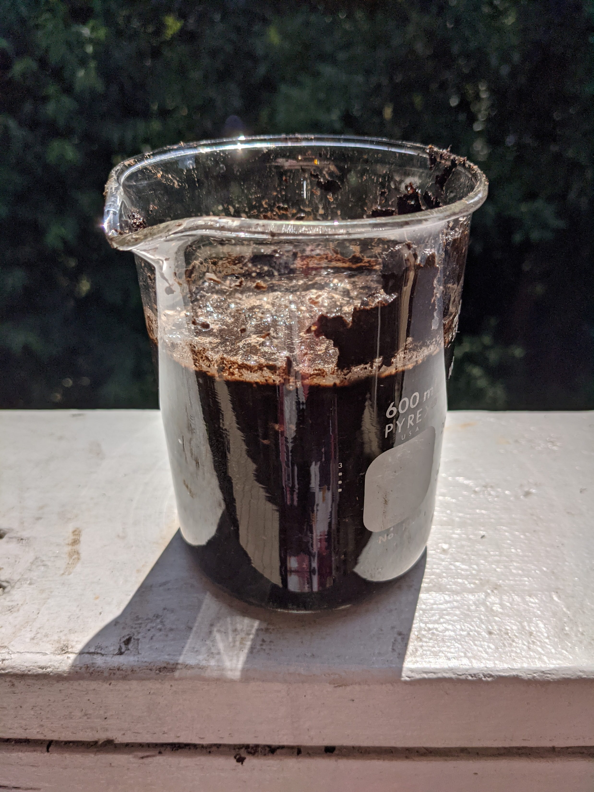
Informal Soil Moisture Measurement Tests

Slide 2
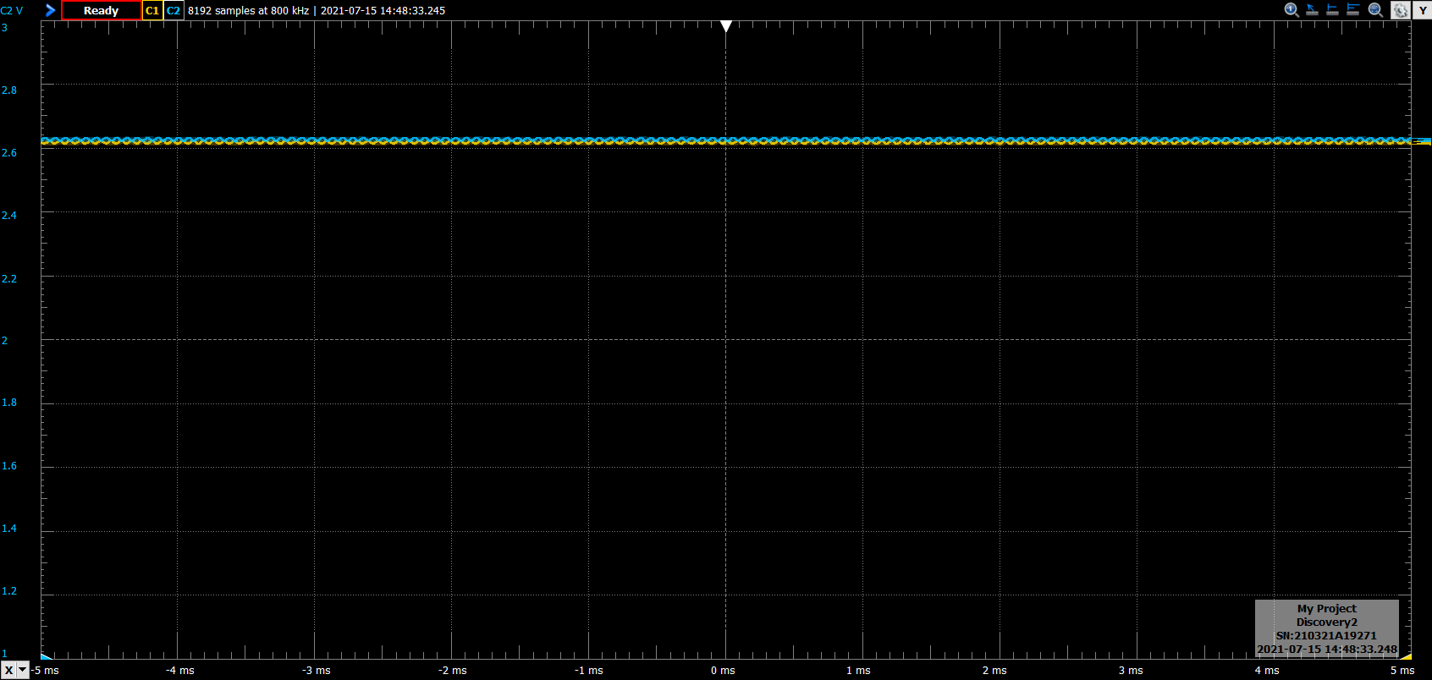
Measurement in air – 2.6V

Slide 3
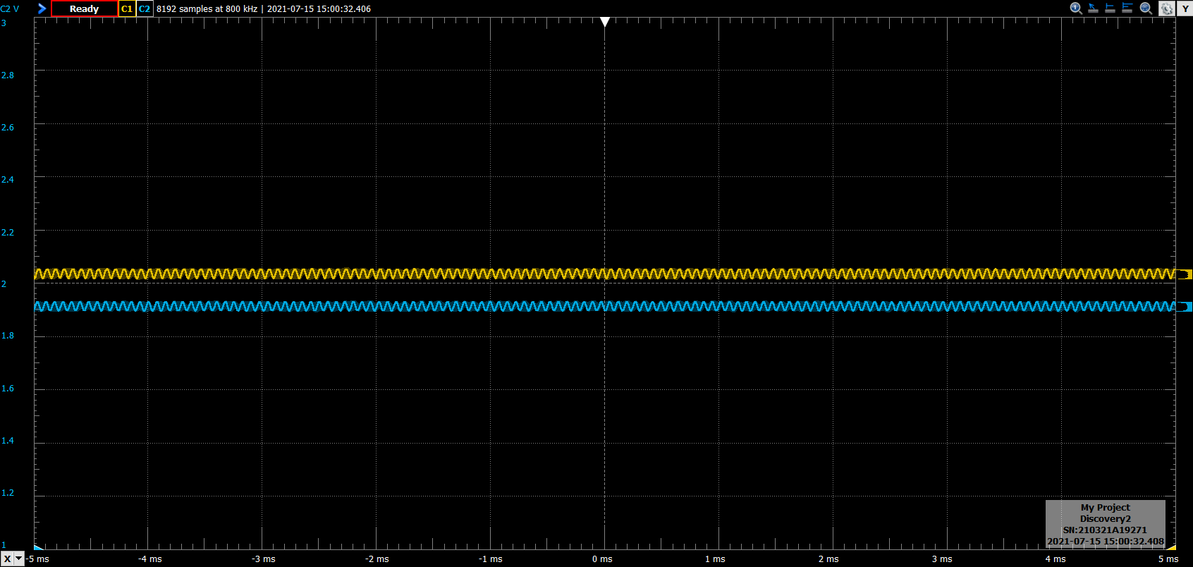
Measurement in soil, no added water – 2.0V

Slide 4
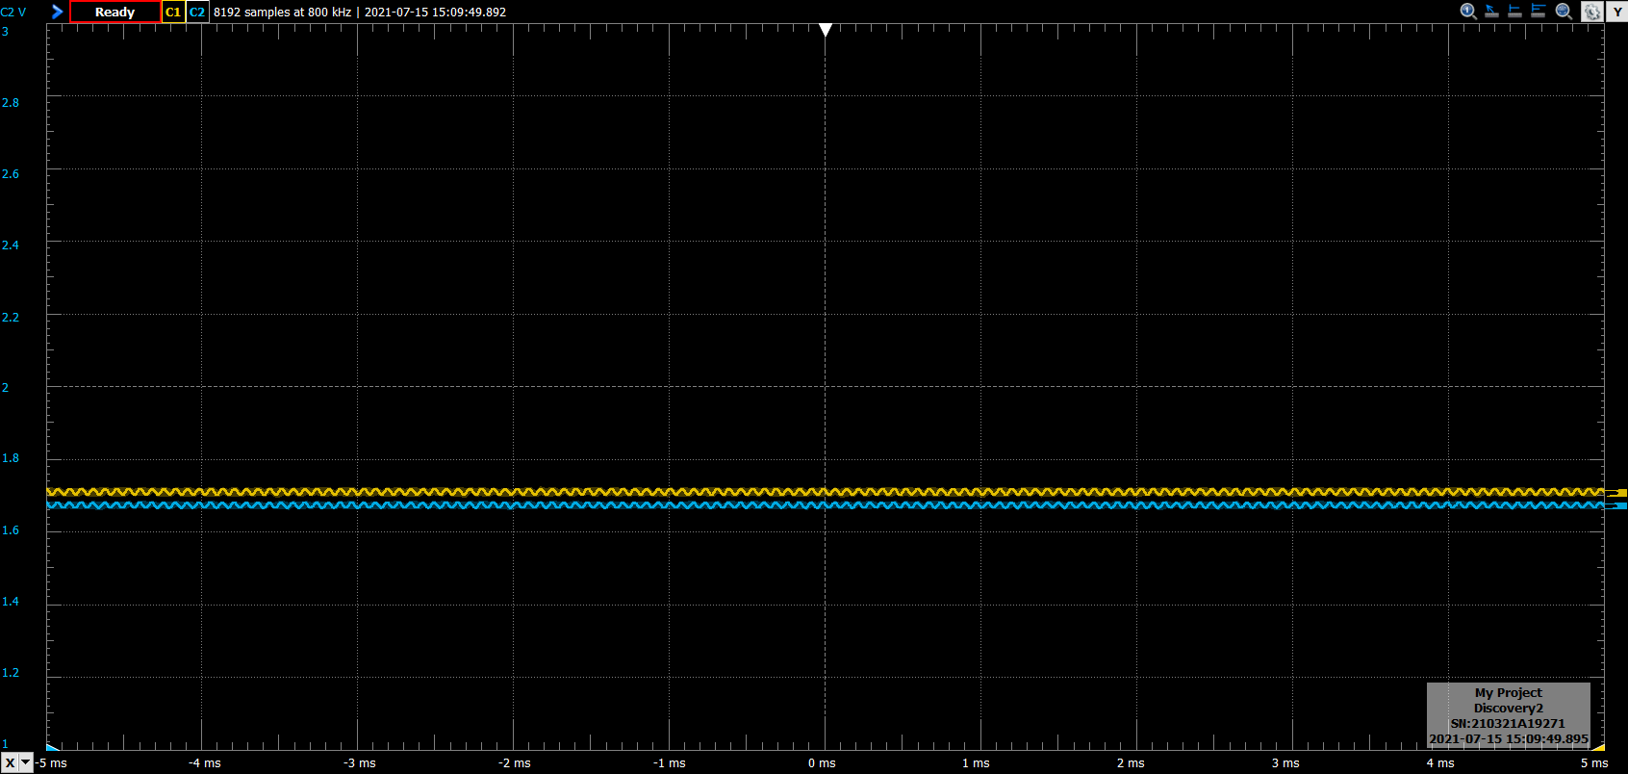
Measurement in soil, 150ml water – 1.7V

Slide 5
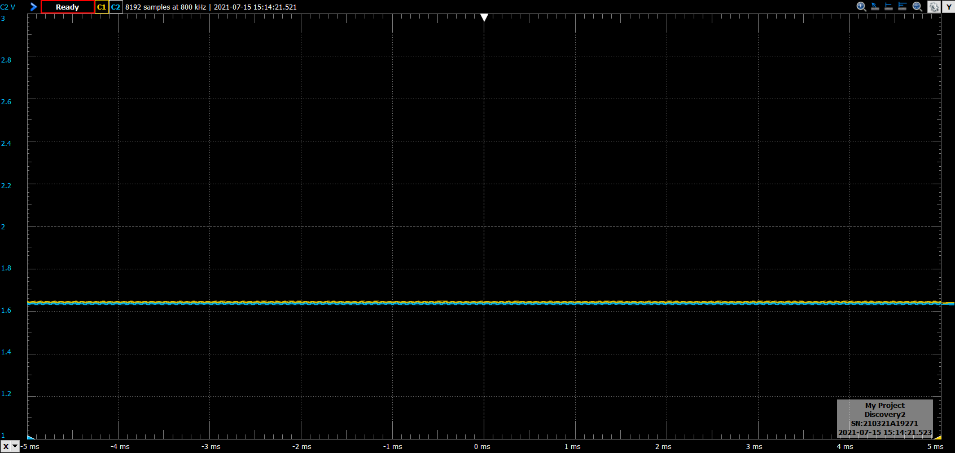
Measurement in soil, 300ml water – 1.64V

Slide 6
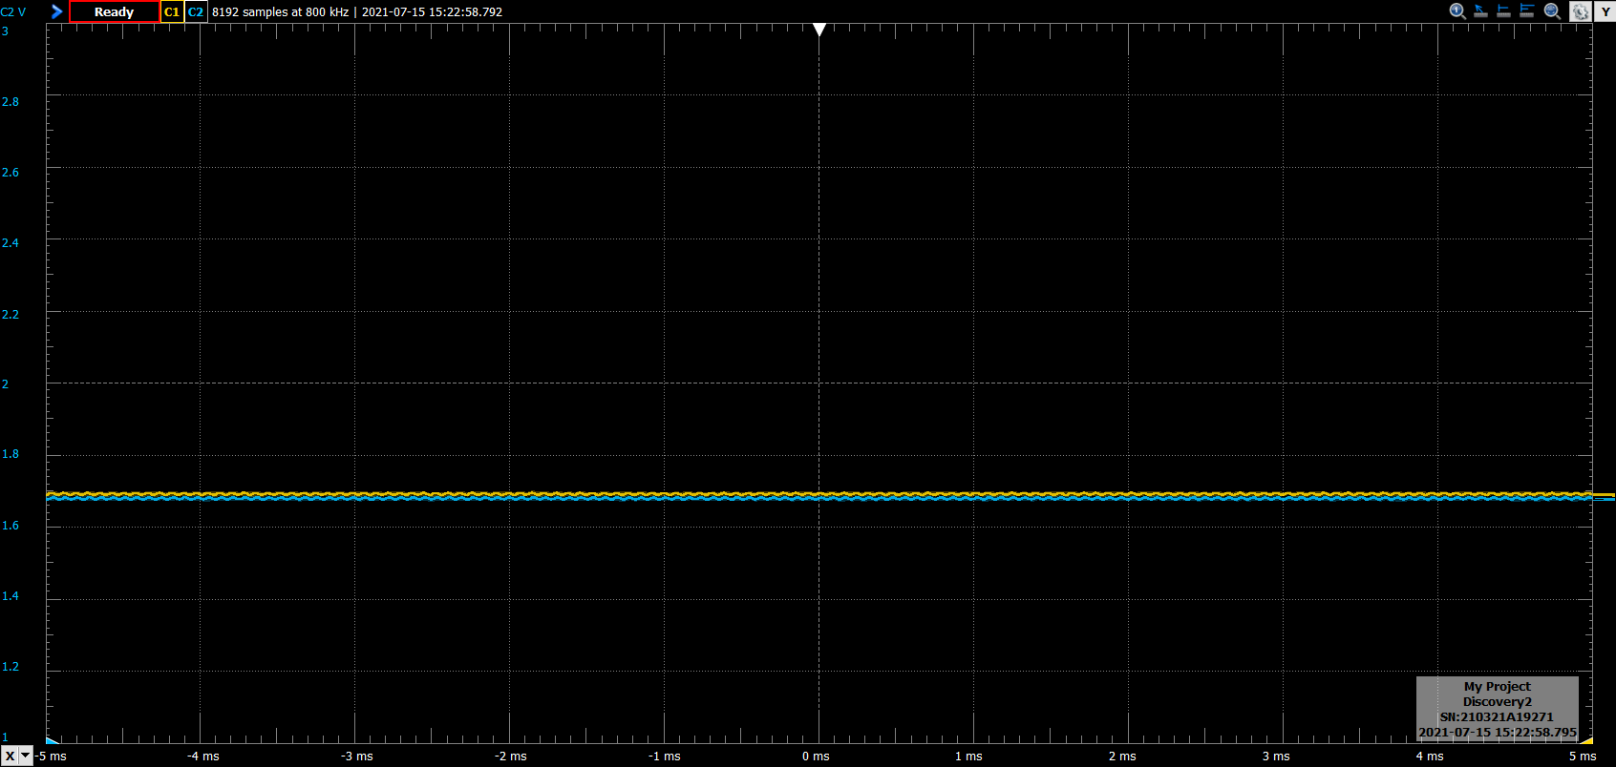
Measurement in just water – 1.7V

Slide 7
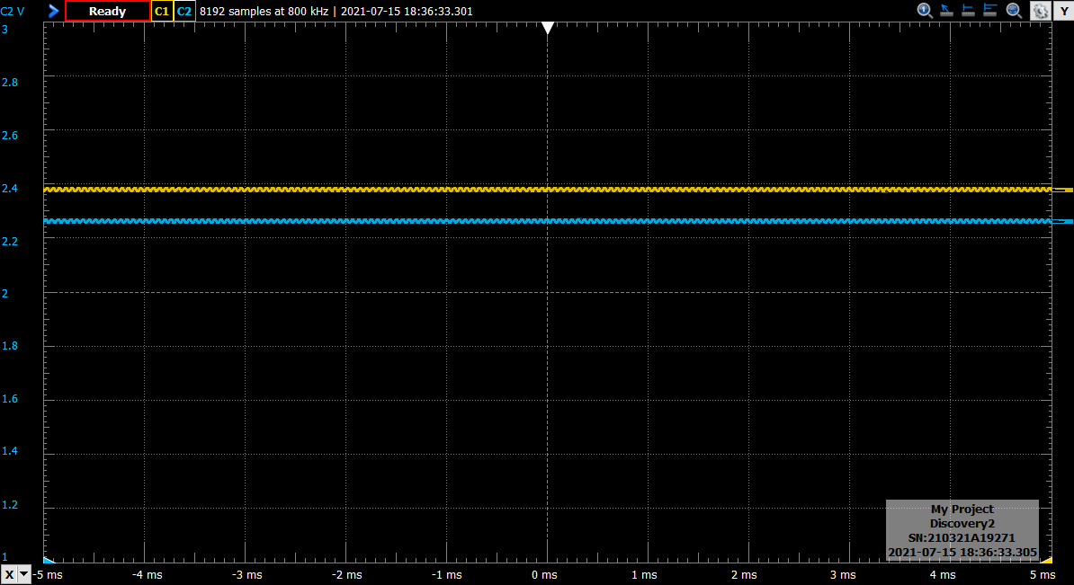
Measurement after baking – 2.4V

Slide 8
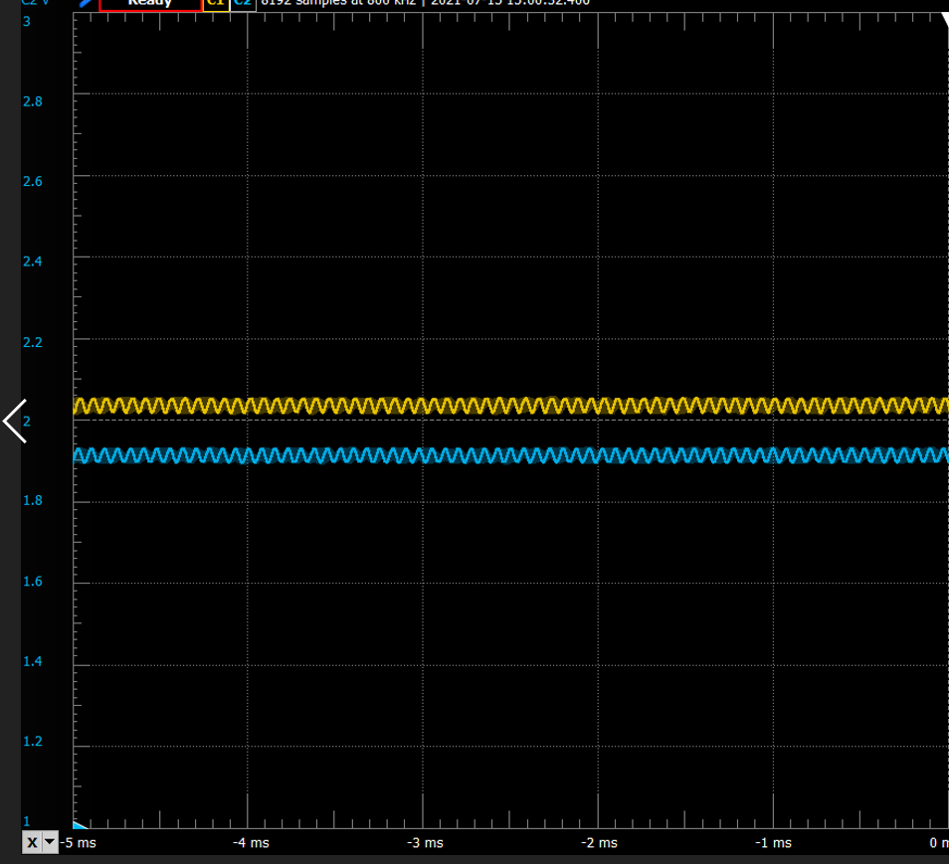
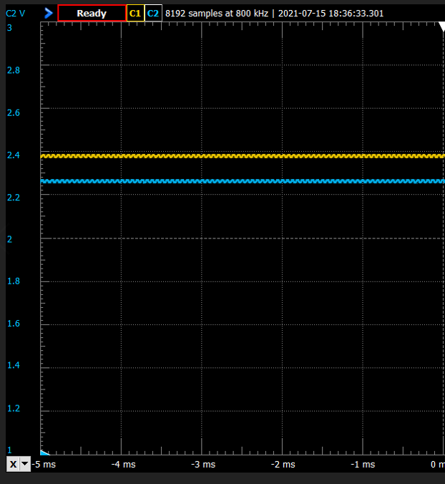
Side by side – pre vs. post bake

Slide 9
Details
Next week:
Program in Wi-Fi sensor network
Develop calibration procedure
Question: will we have some kind of router out in the field?
Will one pod act as the server, and if so, will storage space for data be an issue?
Will we just put a laptop out there?
Decision made: funnel data to a Thingspeak server

